Slide 2
Contents
Number Bots on Parade
Confusing Post
Missing Numbers Washing Line
Missing Train Carriages
Little Red Riding Hood Number Path
Freddie Frog’s Lily Pad Line
Acorn Collection Day
Ready, Steady, GO!
Oopsy Daisy!

Slide 3


Number Bots on Parade
Which number bot is first in the line?
Can you read all of the numbers?
It is time for the number bots parade! They need to line up in order. Can you click on the number bots in order from 1 to 10?
What number bot would be after number 10?
click again
reset
4
2
6
10
5
1
3
8
9
7
Click on the big robot to reveal questions that encourage the development of children’s mathematical reasoning skills.

Slide 4



Confusing Post
What number house do you think came before house number 5?
How can you work out which houses Polly should deliver her three letters to?
Can you say the order of numbers from 5 to 10 out loud?
Polly, the postal worker, is very confused. She has three letters left to deliver. However, some of the houses don’t have numbers. So, Polly does not know which houses to deliver the letters to. Can you help her?
click again
reset
5
7
9
10 Bluebell Road
6 Bluebell Road
8 Bluebell Road
Click on Polly to reveal questions that encourage the development of children’s mathematical reasoning skills.

Slide 5


Missing Number Washing Line
Can you tell me how many numbers are missing altogether?
Which numbers in the box are not the missing numbers from the line?
Some of the numbers have fallen off the washing line! Look at the numbers in the box. Can you click on the ones that are missing from the line?
Which is the smallest missing number?
click again
reset
1
2
0
2
3
5
6
8
10
4
5
7
9
10
Click on the sun to reveal questions that encourage the development of children’s mathematical reasoning skills.

Slide 6
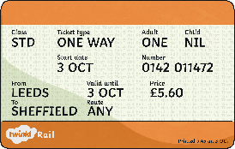

Missing Train Carriages
How do you know which train carriage comes after the number 11 train carriage?
What train carriage would come after the number 15 train carriage?
Some of the train carriages have gone missing! Can you help to put the train carriages into the correct part of the train?
If the train had 20 carriages, do you know what order the carriages from 15 to 20 would need to be placed in?
click again
reset
10
11
14
15
12
13
Click on the train ticket to reveal questions that encourage the development of children’s mathematical reasoning skills.

Slide 7



Little Red Riding Hood Number Path
Little Red Riding Hood is walking to Grandma’s House. Can you complete the path by clicking on the missing numbers?
Do you need to start back at 1 each time?
How can you work out the missing numbers?
5
7
10
click again
reset
1
9
12
15
2
11
13
18
15
3
14
16
8
9
13
17
4
10
20
7
6
11
19
Click on the Big Bad Wolf to reveal questions that encourage the development of children’s mathematical reasoning skills.

Slide 8


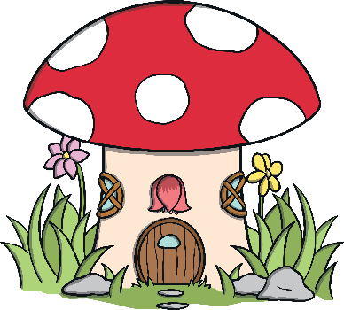


Freddie Frog’s Lily Pad Line
Which number lily pad does Freddie Frog land on first?
Does 14 always come after 13?
Freddie Frog is trying to get across the pond by jumping on the lily pads. Can you place the lily pads in the correct order to help Freddie Frog?
What number would come after 15?
click again
reset
13
14
11
15
12
Click on Dudley Duck to reveal questions that encourage the development of children’s mathematical reasoning skills.

Slide 9



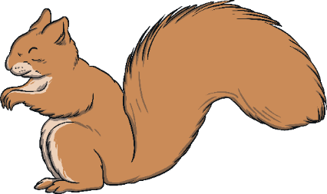
Acorn Collection Day
If there was one more acorn to collect after 20, what number would it be?
Sonny has already eaten the acorn before 11. What number was that acorn?
20
Sonny Squirrel is collecting acorns.
He already has the number 11. Now, he needs to collect the other acorns in the correct order. Can you click on the tree to get the acorns? Can you say which number comes next before
it falls?
14
19
17
13
15
18
16
12
click again
reset
11
Click on the leaf to reveal questions that encourage the development of children’s mathematical reasoning skills.

Slide 10





Ready, Steady, GO!
Which numbers are missing?
Which is the largest number on the racing cars?
Before the race can begin, the cars need to be in the correct order. The smallest number needs to start at the bottom and the largest number should be at the top. However, some of the cars are not ready yet. Can you click on the cars in the order that they need to go in?
click again
reset
Click on the flag to reveal questions that encourage the development of children’s mathematical reasoning skills.

Slide 11


Oopsy Daisy!
Can you tell me which number will come first? Why do you think that?
Daisy has got her numbers all mixed up. Can you help her to put them into the correct order from smallest to largest? Click on the numbers in the order you think they need to go in.
Which is the largest number? Where does it need to go?
click again
reset
20
5
15
Click on the daisy to reveal questions that encourage the development of children’s mathematical reasoning skills.

