Slide 2

Question 1
On what day is Easter celebrated?
April 25th
December 25th
It is a different day every year.
October 31st

Slide 3
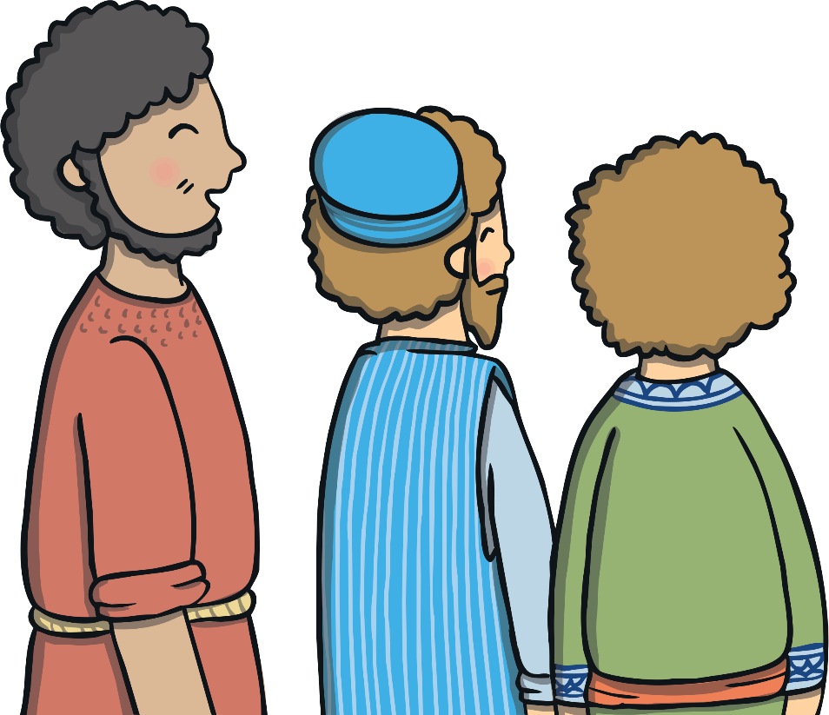
Question 2
What were Jesus’ group of friends called?
the gang
the disciples
the priests
the team

Slide 4
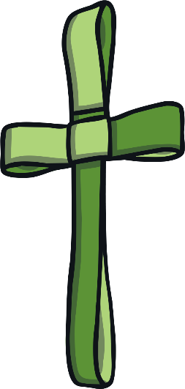

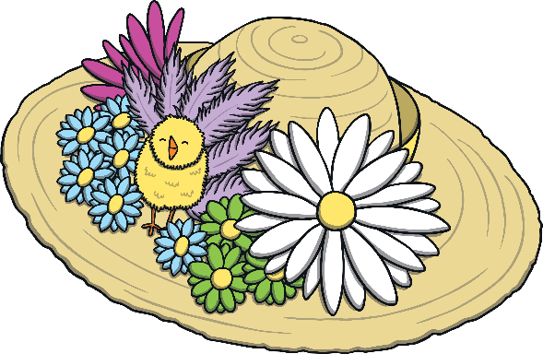
Question 3
Traditionally, what might you wear on your head at Easter?
Easter bonnet
sunhat
palm cross
nothing

Slide 5
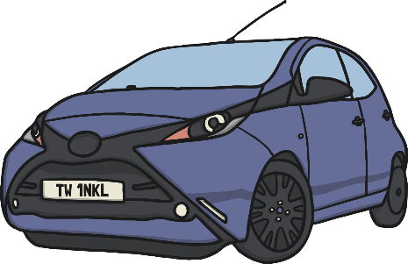
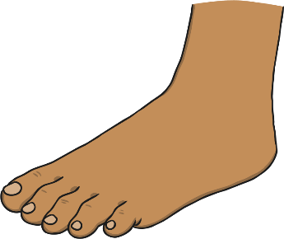
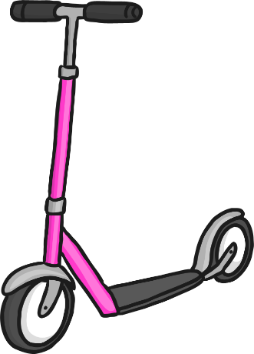
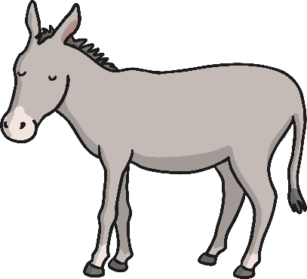
Question 4
How did Jesus travel into Jerusalem on Palm Sunday?
by car
on foot
on a scooter
on a donkey

Slide 6
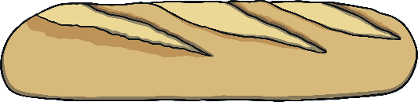
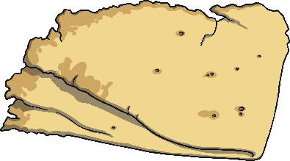

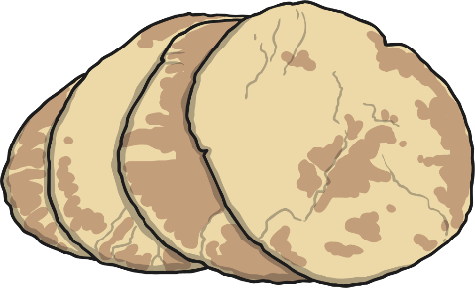
Question 5
What are traditionally eaten on Good Friday?
hot cross buns
flatbreads
baguettes
pitta breads

Slide 7
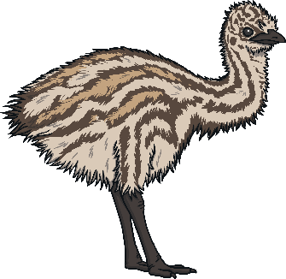
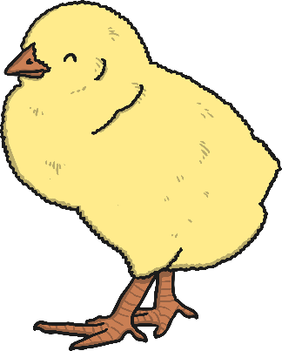
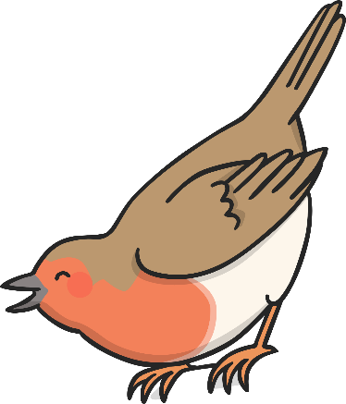
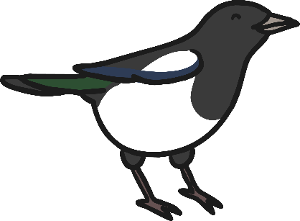
Question 6
Which of these birds is often seen as a symbol of Easter?
emu
chick
magpie
robin

Slide 8
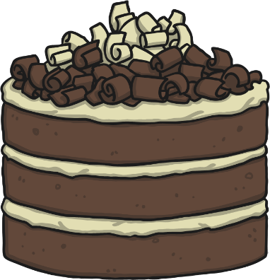
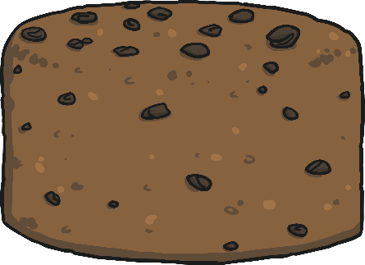
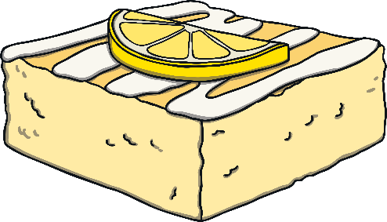
Question 7
What is the traditional cake eaten at Easter?
chocolate cake
fruit cake
lemon cake
simnel cake

Slide 9

Question 8
Which type of chocolate do people often eat at Easter time?
hot chocolate
chocolate sheep
chocolate drops
chocolate eggs

Slide 10
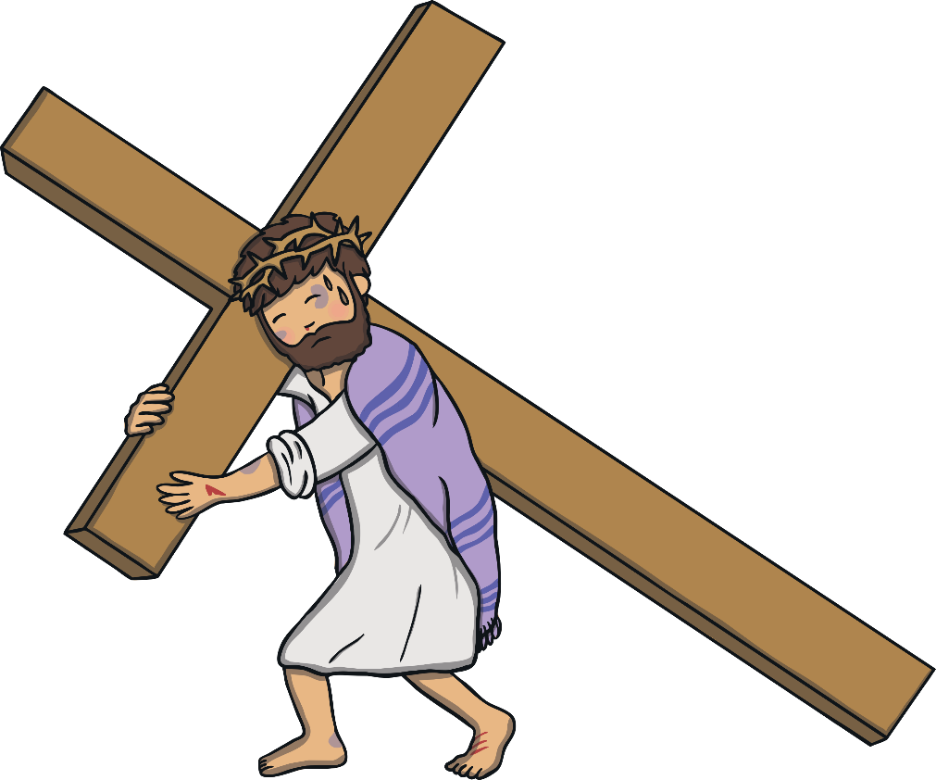
Question 9
When do Christians believe Jesus died?
Easter Sunday
Good Friday
Maundy Thursday
Palm Sunday

Slide 11
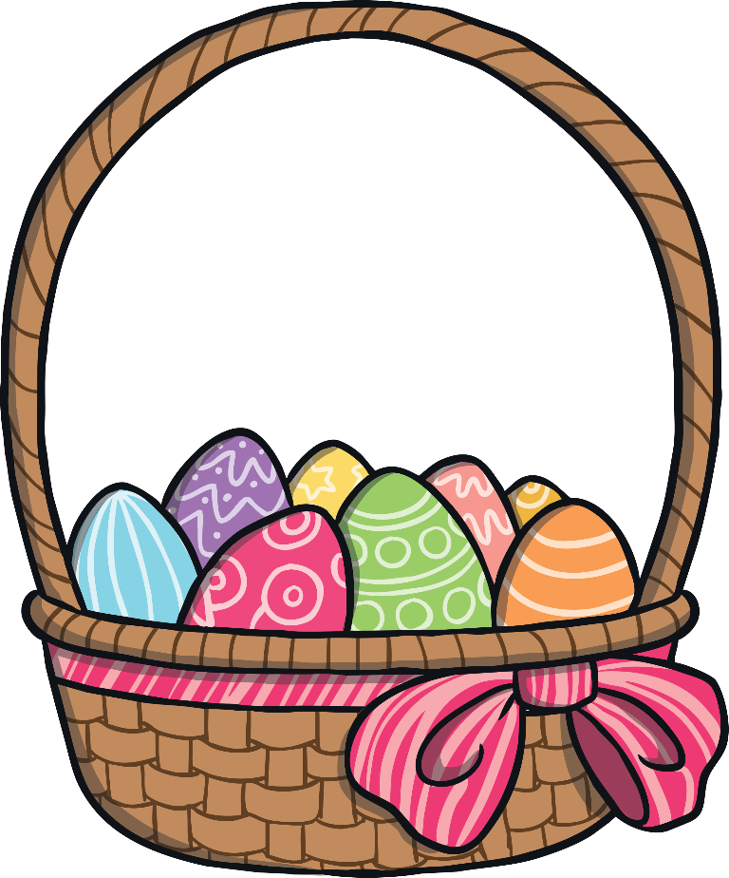
Question 10
How many Easter eggs were sold in the UK last year?
1 million
10 million
80 million
800 million

