Slide 2
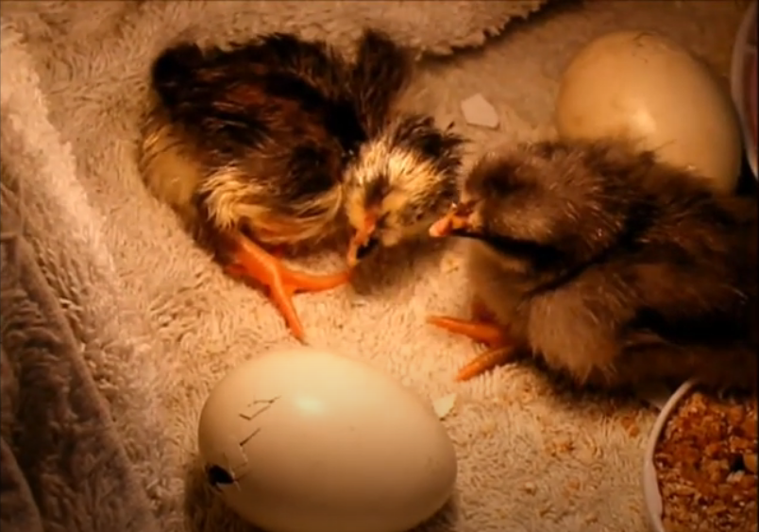

Slide 3
How do you think the chick will change as it grows?
How long do you think it will take for the chick to become an adult chicken?

