Slide 2

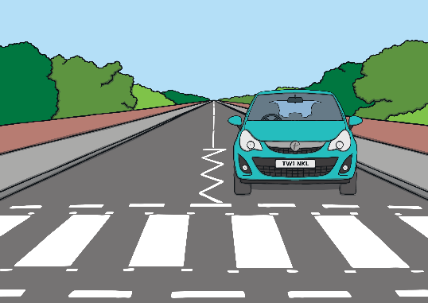
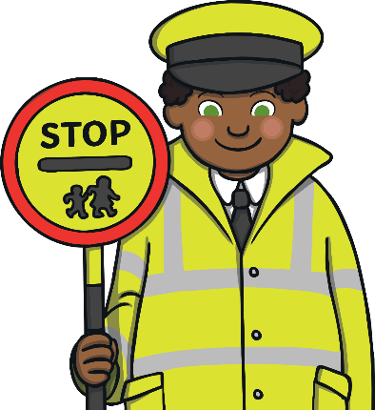
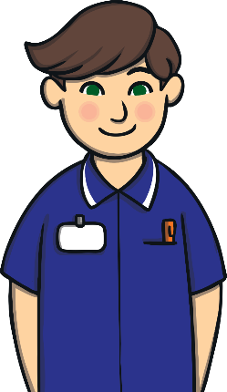


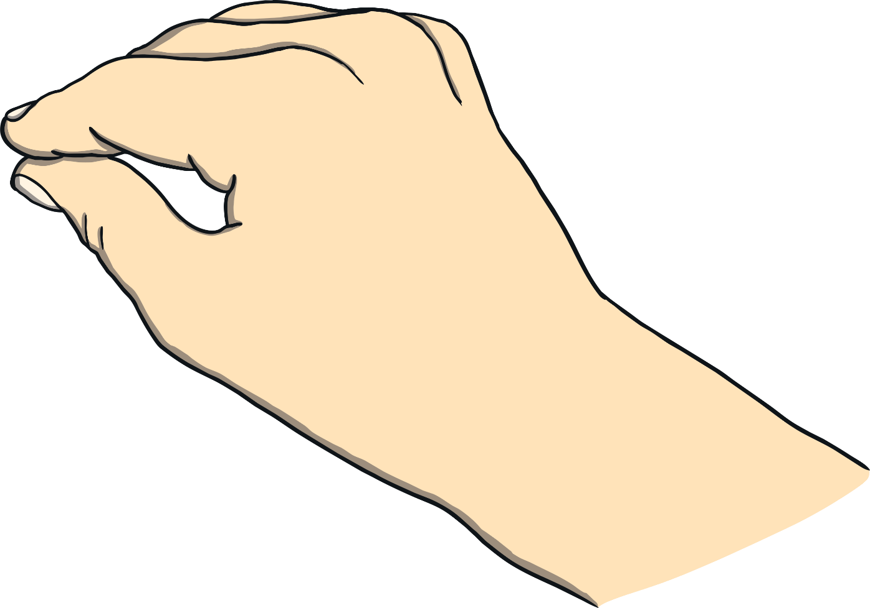
I need to cross the road.
Correct. Good job!
Never mind. Try again!
Who can help me?
or
Next
Lollipop person
Nurse

Slide 3

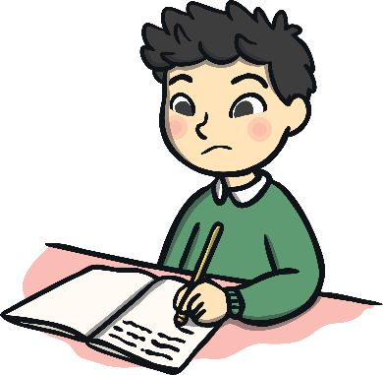


I need help with my work.
Correct. Good job!
Never mind. Try again!
Who can help me?
or
Next
Police
Teacher

Slide 4


I am lost.
Correct. Good job!
Never mind. Try again!
Who can help me?
or
Next
Police
Nurse

Slide 5


My dog is sick.
Correct. Good job!
Never mind. Try again!
Who can help me?
or
Next
Vet
Lollipop person

Slide 6



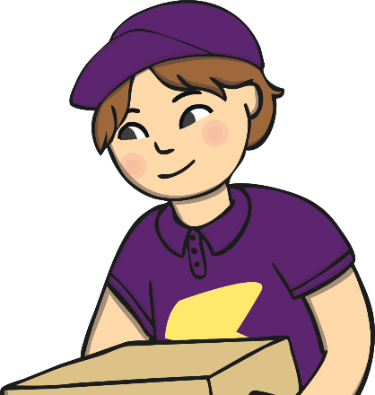

I need to move house.
Correct. Good job!
Never mind. Try again!
Who can help me?
or
Next
Doctor
Removal person

Slide 7


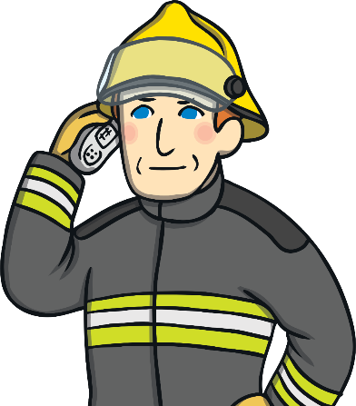
There is a fire.
Correct. Good job!
Never mind. Try again!
Who can help me?
or
Next
Lollipop person
Firefighter

Slide 8
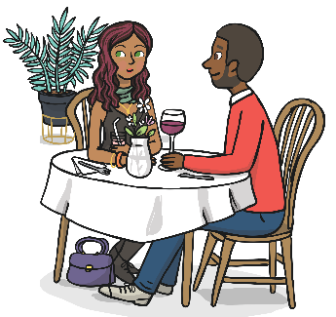


I would like to order some food.
Correct. Good job!
Never mind. Try again!
Who can help me?
or
Next
Waiter
Police

Slide 9
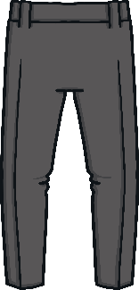
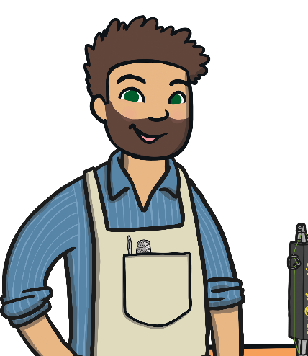

My trousers are too long.
Correct. Good job!
Never mind. Try again!
Who can help me?
or
Next
Sewer
Postal worker

Slide 10

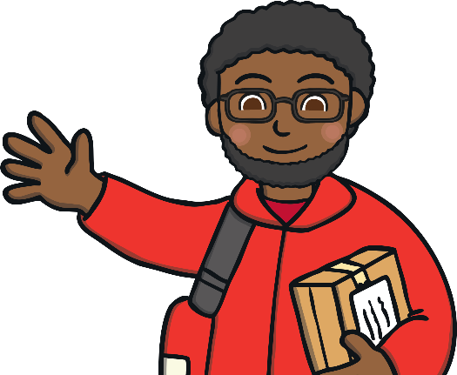

I have hurt my knee.
Correct. Good job!
Never mind. Try again!
Who can help me?
or
Next
Postal worker
Nurse

Slide 11
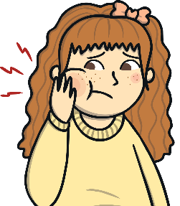
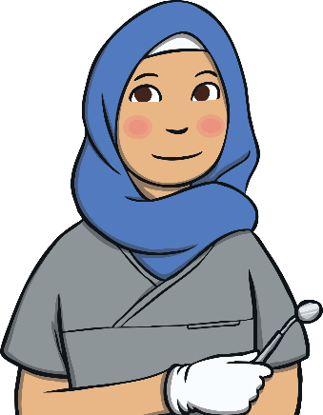
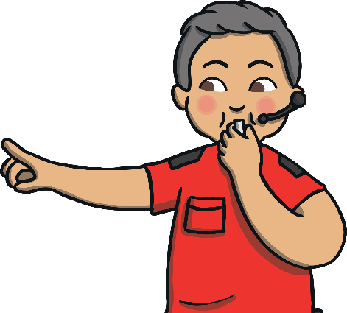
My teeth hurt.
Correct. Good job!
Never mind. Try again!
Who can help me?
or
Next
Dentist
Referee

Slide 12


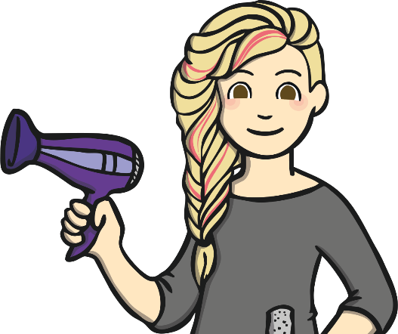
I want to change my hairstyle.
Correct. Good job!
Never mind. Try again!
Who can help me?
or
Next
Waitress
Hairdresser

Slide 13



I just got fouled.
Correct. Good job!
Never mind. Try again!
Who can help me?
or
Next
Sewer
Referee

Slide 14

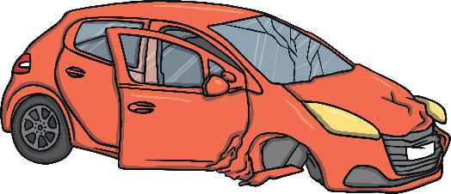
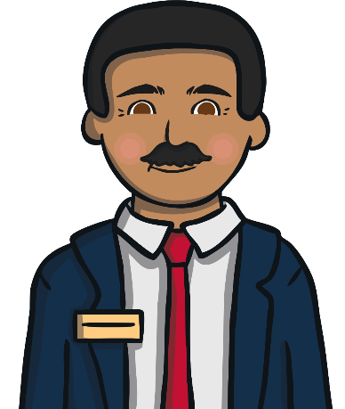


I need a new car.
Correct. Good job!
Never mind. Try again!
Who can help me?
or
Next
Car sales person
Teacher

Slide 15
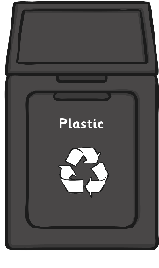
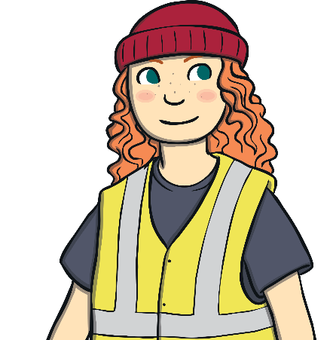

My bin is full.
Correct. Good job!
Never mind. Try again!
Who can help me?
or
Next
Bin collector
Vet

