Slide 2
We hope you find the information on our website and resources useful. This resource contains links to external video websites. These websites often have autoplay features meaning that other videos will play after the video you are watching finishes. You should disable this feature before using the video in any classroom or similar setting. Twinkl assumes no responsibility for the contents of linked websites. The inclusion of any link in this resource should not be taken as an endorsement of any kind by Twinkl of the linked website or any association with its operators. We have no control over the availability of the linked pages. If the link is not working, please let us know by contacting TwinklCares and we will try to fix it, although we can assume no responsibility if this is the case.

Slide 3



Note down some of the things you see.

Slide 4
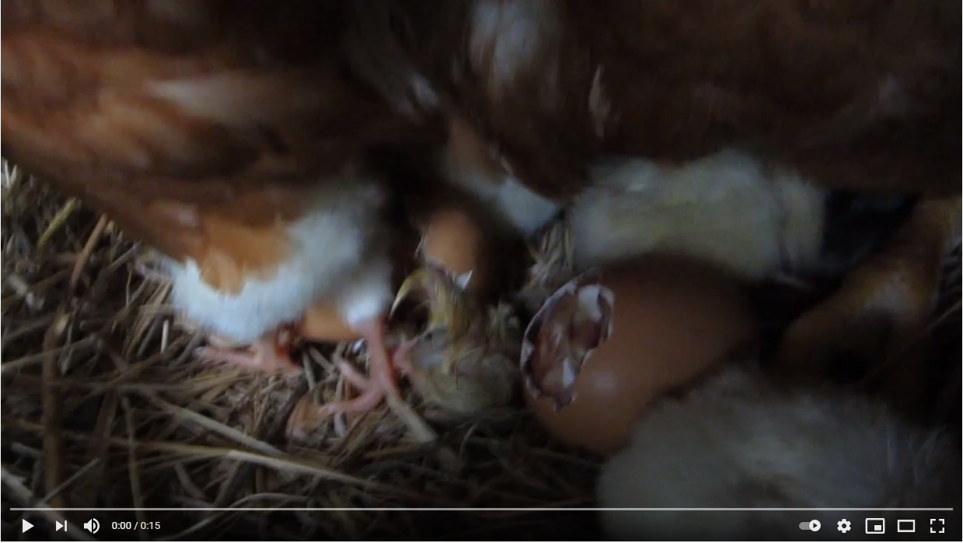
Photo courtesy of Abi Haigh (@youtube.com) - granted under creative commons licence – attribution

Slide 5
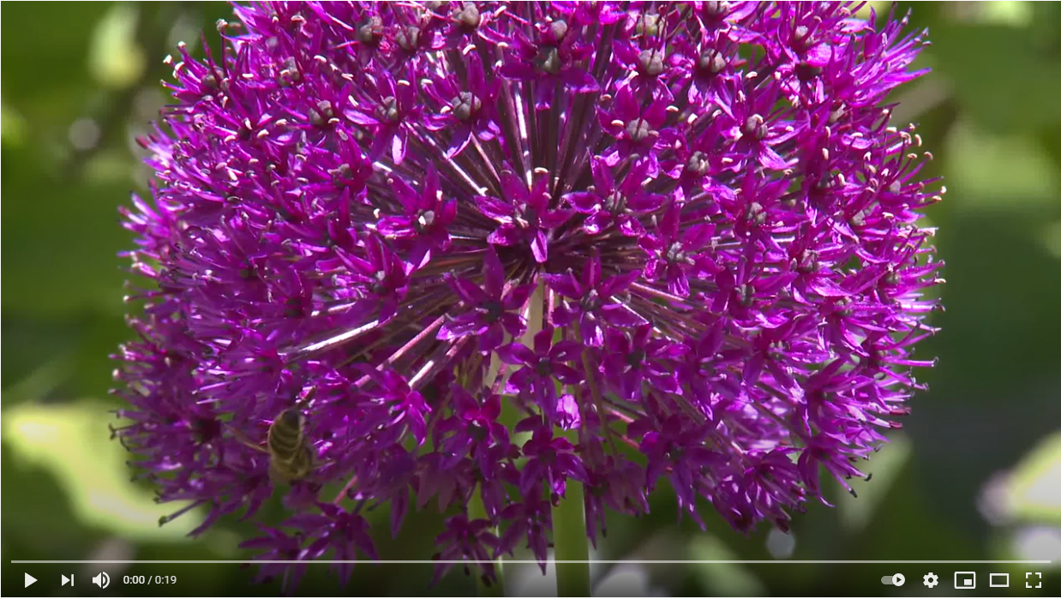
Photo courtesy of Abi Haigh (@youtube.com) - granted under creative commons licence – attribution

Slide 6
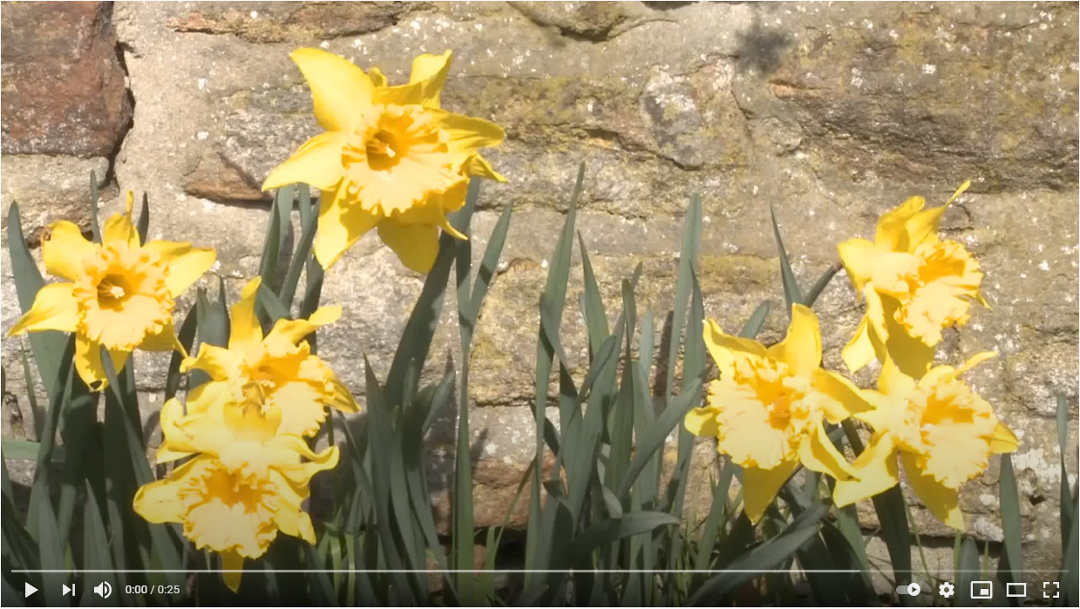
Photo courtesy of Abi Haigh (@youtube.com) - granted under creative commons licence – attribution

Slide 7
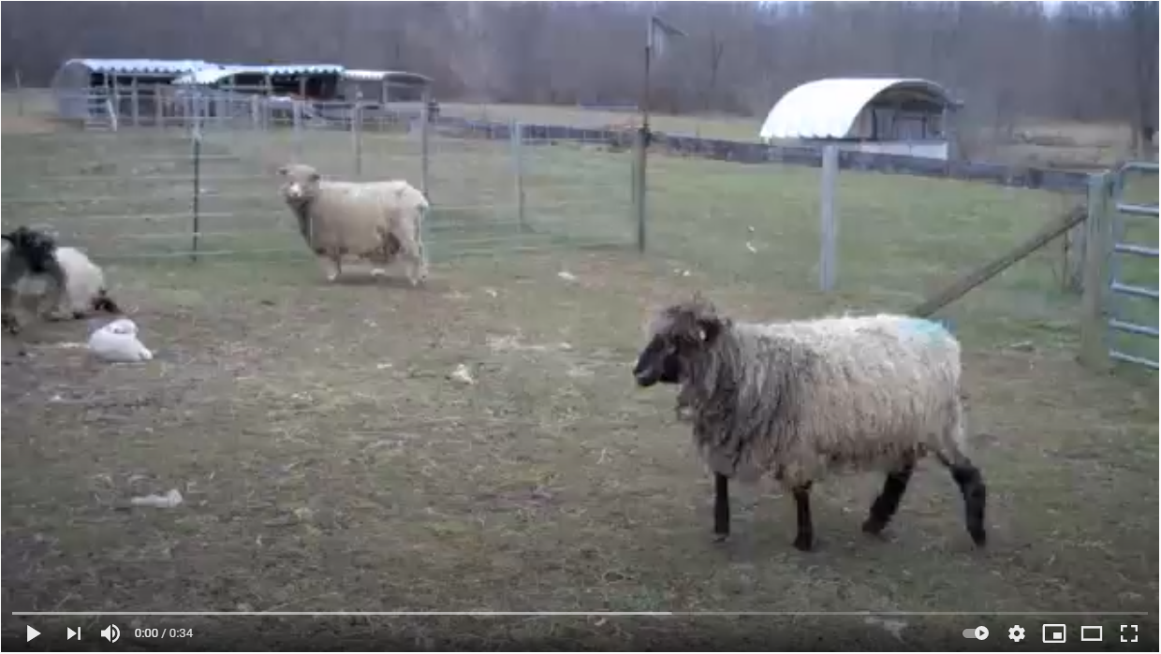
Photo courtesy of Abi Haigh (@youtube.com) - granted under creative commons licence – attribution

Slide 8
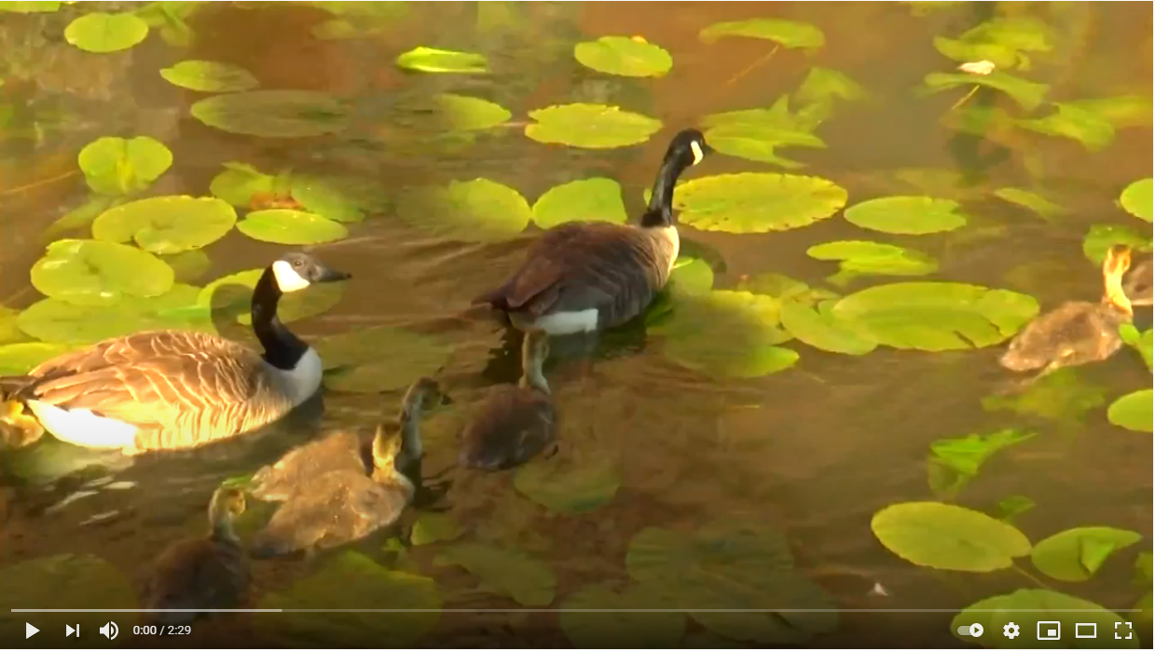
Photo courtesy of Abi Haigh (@youtube.com) - granted under creative commons licence – attribution

Slide 9
What did you see?

