Slide 2
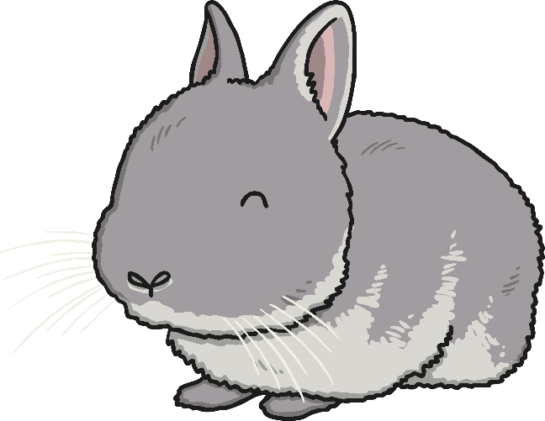
Instructions
Hello everyone!
My name is Baby Bunny.
I love to jump and bounce along my number line.
Can you help me work out which numbers I will land on?

Slide 3
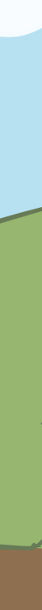
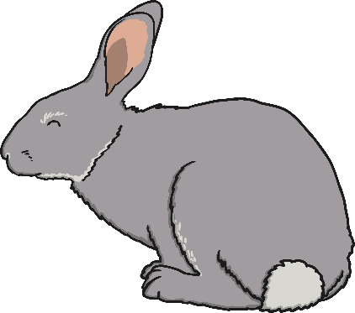

Baby Bunny is on 0. He jumps on 1 more.
What number will he land on?
Click me to help me jump!
0
1
2
3
4
5
6
7
8
9
10
0 and 1 makes 1

Slide 4
Baby Bunny is on number 1. Can you count on
1 more? Which number will Baby Bunny land on?
Click me to help me jump!
0
1
2
3
4
5
6
7
8
9
10
1 and 1 makes 2

Slide 5
Baby Bunny is on number 2. He jumps on 1 more.
What does 2 add 1 make?
Click me to help me jump!
0
1
2
3
4
5
6
7
8
9
10
2 add 1 makes 3

Slide 6
Baby Bunny is on number 3. He jumps on 1 more.
Can you count on to find which number Baby Bunny
will land on? How do you know?
Click me to help me jump!
0
1
2
3
4
5
6
7
8
9
10
3 add 1 makes 4

Slide 7
Baby Bunny is on number 4. He jumps on 1 more.
What do you notice about the number that is 1 more? Where is it on the number line?
Click me to help me jump!
0
1
2
3
4
5
6
7
8
9
10
4 add 1 equals 5

Slide 8
Baby Bunny is on number 5. He jumps on 1 more.
I think he will land on number 4. Am I correct?
Why? Why not?
Click me to help me jump!
0
1
2
3
4
5
6
7
8
9
10
5 add 1 equals 6

Slide 9
Which number will Baby Bunny land on if he makes 2 more jumps along the number line? Can you use the number
line or your fingers to help you work out the answer?
Click me to help me jump!
0
1
2
3
4
5
6
7
8
9
10
6 + 2 = 8

Slide 10
Baby Bunny is going to make 2 more jumps.
Can you tell a friend a number sentence about
these jumps?
Click me to help me jump!
0
1
2
3
4
5
6
7
8
9
10
8 + 2 = 10

Slide 11
Thank you for helping me work out which numbers I would land on.
You could try pretending to be bunnies and jump along a number line too!
Play Again

